Slide 1
Network Based Travel Demand Model –Forecasting Tool Using GPS Data
Modeling Mobility Conference
Kazi Ullah
Contributors – Nikhil Puri and Niloofar Ghahramani

Slide 2
Background
Sponsoring Authority: Herkimer-Oneida Counties Transportation Council (HOCTC)
Study Area: I-90 Exit 31 interchange and surrounding roadways in Utica, NY
Goal: The study aims to improve connections between key roadways, increase safety and enhance mobility for all users
Task Goal: To develop a prototype travel demand model (TDM) for a small Metropolitan Planning Organization (MPO) using big data that can be used for existing and future network operations

Slide 3
Model Framework
Model Steps are similar to developing a four-step model as follows
TAZ Development
Network Development
Data
TomTom – OD & travel speeds
Traffic Counts
OD Matrix - Expansion
Validation
Travel speeds/times
Volumes
Calibration
Application

Slide 4
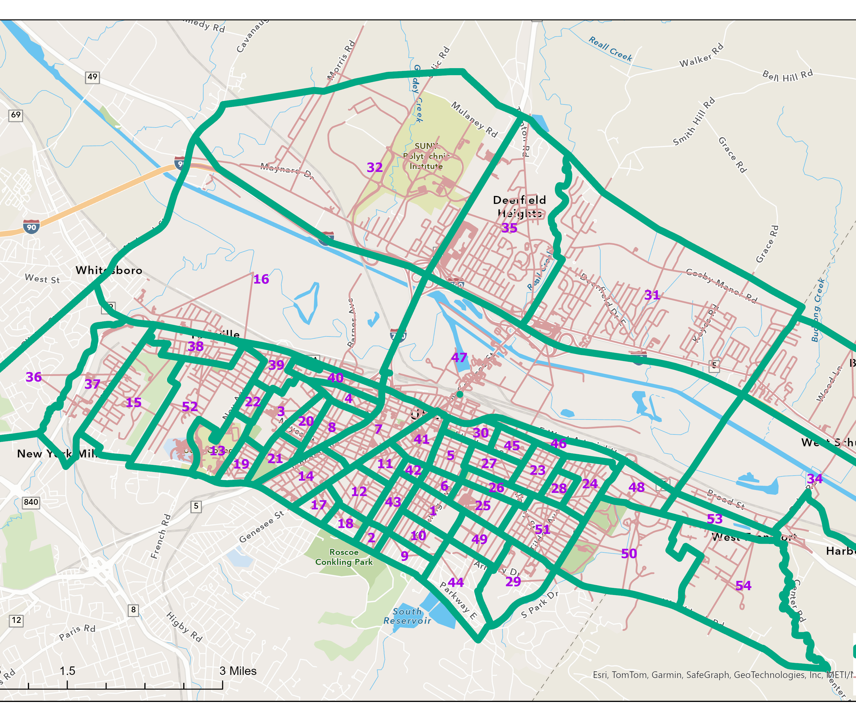
TAZ development
Any model needs a reasonable Transportation Analysis Zone (TAZ)
Each TAZ represents zonal activity of the model
Block Group (BG) Data is used to create TAZ structure
Some big BGs are split to create new zones
Some small BGs are added together to create a reasonable zonal boundary
Each Taz has population and employment for year 2023
Total number of TAZs is 54 in the study area

Slide 5
Source of network in study area
We used TomTom network to develop our study area network
TomTom network is converted into TransCAD network
The network is cleaned up by excluding all small roads and driveways.
TomTom network has speed data which is translated into TransCAD network.
Tomtom speed data is used to develop a speed lookup table based on facility type.
This speed data is adjusted during model calibration
A lookup table for capacity is developed based on other similar models

Slide 6
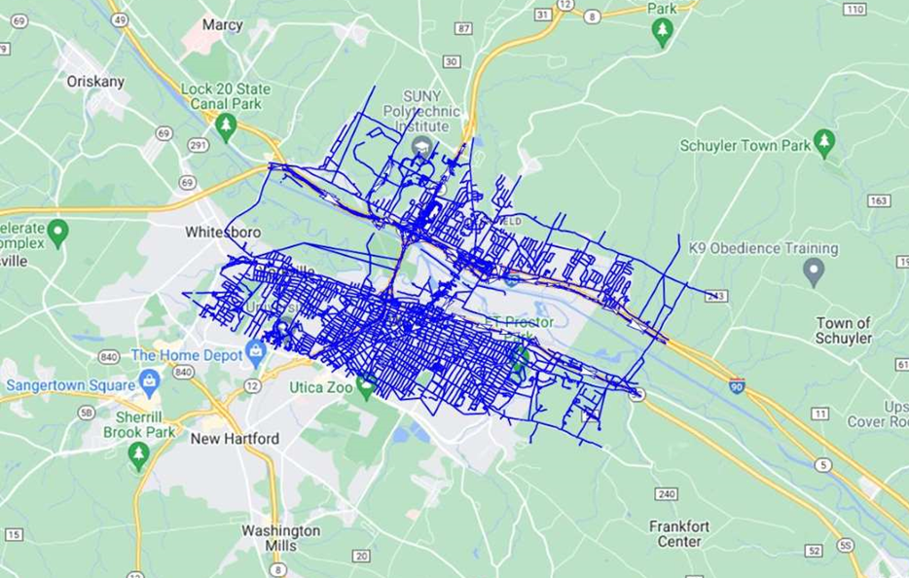
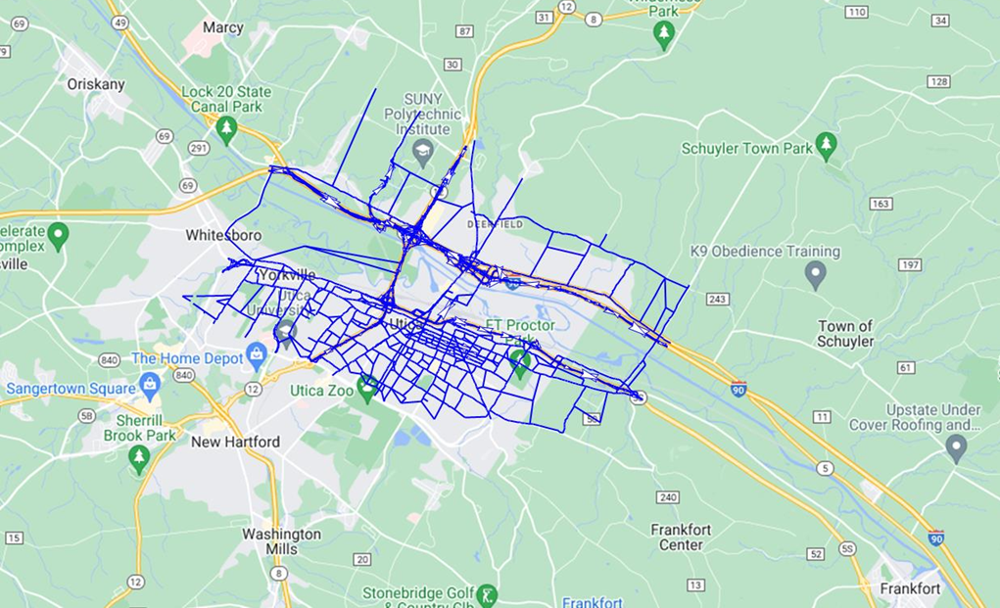
TomTom Network with and without local streets

Slide 7
Network development
Lookup table is used to update speed and capacity in the network
Name | Fclass | Cap_Per_Lane | Observed_Speed | Proposed_FF_Spd
Interstate | 1 | 2000 | 72.76 | 65
Freeways/Expressways | 2 | 1900 | 50.08 | 60
Principal Arterial | 3 | 1600 | 35.16 | 45
Minor Arterial | 4 | 1500 | 29.37 | 42
Major Collector | 5 | 1400 | 29.98 | 35
Minor Collector | 6 | 1200 | 20.32 | 30
Local Roads/CC | 7 | 1100 | 10.78 | 20
Ramp | 8 | 1200 | 42.09 | 35

Slide 8
Network development
Network needs to have TAZs consistent with TAZ structure
These TAZs or centroids have been developed using TransCAD's algorithm
Each centroid represents activity at that TAZ
Connections need to be added to connect the acitivity center to the nearby roads.
These connectors are called centroid connectors. Each TAZ has 2 or 3 cennectors connecting to the nearby roads.

Slide 9
Network connectivity check
TomTom network has some connectivity issues, such as I-90 overpass is actually connected with Rt.12, Newport Road etc.
These connectivity issues have been solved by updating the network.
Network skim is performed to make sure all zones are connected properly.
This is needed to ensure proper flow of traffic when the trip table are assigned.

Slide 10
Observed traffic counts
External Links
Data Source: 2021 AADT data from NYSDOT Traffic Viewer
Internal Links
Turning Movement Counts at Intersections (17 intersections)
Midway Link Segment Counts (18 locations)
Data Source: Weekday counts collected at locations on Oct 3 to Oct 5 2023
AM and PM period at Traffic Intersections (15-minute intervals)
Daily counts at midway link segment locations (15-minute intervals)

Slide 11
Preparation of trip table for base year 2023
Origin-destination flow from TomTom data is used to create a sample trip table based on TAZs of the study area
The sample table is then expanded based on traffic counts at the external locations and at some other places
Final trip table is developed for daily, am and pm peak hour based on traffic counts

Slide 12
Validation Effort
The traffic model developed was compared against traffic counts.
This comparison gave us a sense how good is the base year model validated.
Initially validation was done against daily counts by changing network characteristics such as speed and capacity
Some zones are split to ensure proper traffic activities
Base year model is for year 2023.
Once the model was validated reasonably well against the counts on the roads, the base year trip table can be used to develop future year trip tables.

Slide 13
Base year validation
The table below shows final daily validation numbers after several iterations
Functional Classification | Fclass | #LINKS | Count | Volume | Percent Diff | RMSE
Interstate | 1 | 6 | 69,857 | 67,346 | -3.6% | 8.0%
Freeways/Expressways | 2 | 16 | 158,991 | 163,830 | 3.0% | 14.8%
Minor Arterial | 4 | 9 | 82,284 | 74,788 | -9.1% | 40.0%
Major Collector | 5 | 7 | 47,330 | 37,092 | -21.6% | 48.7%
Minor Collector | 6 | 9 | 23,377 | 23,000 | -1.6% | 18.6%
Ramp | 8 | 16 | 55,131 | 46,806 | -15.1% | 57.7%
Total | Total | 63 | 436,970 | 412,862 | -5.5% | 30.3%

Slide 14
Base year validation
Overall RMSE is 30.3% which is consistent with industry best practices
Overall model flow is within -5.5% of traffic counts
There are three important count locations in Genesse Street and overall model flow at these locations are within –8%
Model flows in I-90E and I-90W at the boundaries of subarea are within 1% of traffic counts

Slide 15
Comparison of flows on some important roadways
Street Name | Fclass | Daily_Count | Daily_Volume | Difference | % Difference
Hwy Rt.12 near Lenox Ave. SB | 2 | 16,160 | 18,558 | 2,398 | 14.8%
Hwy Rt.12 near Lenox Ave. NB | 2 | 16,160 | 18,188 | 2,028 | 12.6%
Hwy 5S near Beacon St. WB | 2 | 8,276 | 9,431 | 1,155 | 14.0%
Hwy 5S near Beacon St. EB | 2 | 8,276 | 9,731 | 1,455 | 17.6%
Wurz Ave near Railroad St. | 6 | 7,265 | 8,155 | 890 | 12.3%
Genesee St near Columbia Street | 4 | 8,130 | 9,945 | 1,815 | 22.3%
Genesee St near Pleasant Street | 4 | 8,522 | 8,476 | -46 | -0.5%
N Genesee St. near Weaver St. | 4 | 23,770 | 18,683 | -5,087 | -21.4%
I-90 E near Newport Rd. | 1 | 11,236 | 11,215 | -21 | -0.2%
I-90 W near Newport Rd. | 1 | 11,236 | 11,210 | -26 | -0.2%
I-90 EB near Herkimer Rd. | 1 | 13,259 | 11,215 | -2,044 | -15.4%
I-90 WB near Herkimer Rd. | 1 | 11,626 | 11,210 | -416 | -3.6%
Rt. 12 near Mulaney Rd. | 2 | 5,922 | 5,858 | -64 | -1.1%
Rt. 12 near Mulaney Rd. | 2 | 5,922 | 5,856 | -66 | -1.1%
I-90 W west of Newport Road (eastern boundary) | 1 | 11,200 | 11,210 | 10 | 0.1%
I-90 E before SR-49 (western boundary) | 1 | 11,250 | 11,248 | -2 | 0.0%
 | Total | 178,210 | 180,188 | 1,978 | 1.1%

Slide 16
Develop AM and PM peak hour flows
Due to low number of counts for peak hours we decided to develop AM and PM peak flows from daily model flow
First, adjustment factors were developed based on daily counts and peak hour counts
These factors for AM and PM are developed based on functional class
Daily volumes are then converted to AM and PM peak hour volumes
Turning movements have been developed for AM and PM peak hour from daily turn flows

Slide 17
Future scenario analysis
The model has been applied for 2045 future scenario
Based on socio-economic data between year 2023 and year 2045, base year trip table was expanded using Fratar method.
Trips due to Walmart or big shopping complex that are supposed to be developed before year 2045 are considered using ITE trip generation manual
The above additional trips are added to the trip table based on the distribution of that TAZ or nearby TAZ
This new trip table is then used during future year assignment flows

Slide 18
Conclusion
This tool takes a different approach than traditional travel demand models.
It replaces trip generation and distribution steps of a conventional three-step model by using an expanded trip table derived from big data.
It is designed to be quick and easy to apply.
It offers a relatively lower-cost alternative for a small city or town.

